Slide 1
Interactive Secure Headset
Rob Barton, Morgan Ambourn, Nathan Andersen, Zach Johnson, Asa Pauls, Ehren Fox
Notes:
All of us
Team (roles)
Client
Advisors

Slide 2
Team 1 Information
Client: Cornerstone Strategies, LLC
Advisors: Dr. Diane T. Rover
Team Website:
https://sdmay21-01.sd.ece.iastate.edu/
Team Email: sdmay21-01@iastate.edu
Notes:
Rob

Slide 3
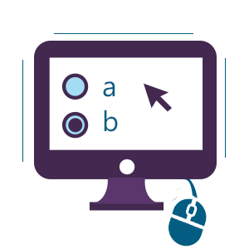
Project Vision: Background
Online testing allows test takers more opportunities to cheat
Exams during Covid-19
Who cares?
Educators
Testing industry, both developers and proctors (ACT, SAT)
Workplaces
Notes:
Nathan Andersen
What is the project attempting to accomplish?
Who cares? Whose life would be improved?
A very high level 1-2 sentence approach
Online testing is something that has become a big topic due to recent events. With a large majority of classes being taught online, exams have also been offered through online tools. Many professors have noted a rise in cheating with the recent shift to online testing.

Slide 4
Project Vision: Background
How to solve this issue of cheating on online testing?
Existing solutions:
Lockdown browsers
Webcam monitoring
Combination of both
These options do have vulnerabilities that could be exploited to either share the test questions, or leaves test taker able to cheat
Notes:
Nathan Andersen
Lockdown browsers:
effective at potentially locking down someone’s computer/monitoring activity
Use of VM’s to get around them, record tests
Test taker could always just use another device to lookup information
Webcam monitoring:
Virtual proctoring
Can only see what the webcam is pointed at
Can’t see what the test taker can see
What if they have notes behind their monitor?
What if someone else is in the room out of sight helping them

Slide 5
Project Vision: Solution
Creating a remote testing environment where it is harder to cheat
Use technology to enhance testing and create an experience that’s harder to cheat than existing methods already available
Developing a wearable headset to solve this
Notes:
Nathan Andersen
A very high level 1-2 sentence approach

Slide 6
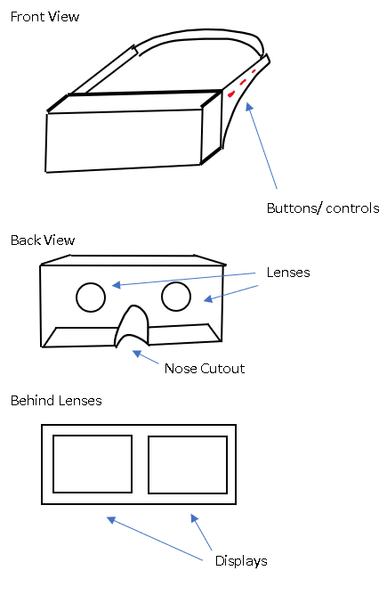
Conceptual/Visual Sketch
Creating a head mounted display (HMD)
Housing the electronics behind the displays in the front of the unit
Buttons and other controls on side of device
Notes:
Nathan Andersen
A concept visual that captures most of the elements – what is being designed?
This is our initial sketch that we drew up of our initial idea. We’re cr

Slide 7
Why This Approach?
Only the test taker can view the exam & their answers
Test content cannot be captured without tampering with device
Test taker unable to see their surroundings, preventing them from accessing outside information not allowed for the exam
Platform able for the addition of sensors to remotely proctor the exam
Notes:
Who is the targeted clientele? What is unique about the approach?
Now that we know what were looking for, he’re Asa to talk about the requirements

Slide 8
Requirements (Functional)
Can be used while charging
Has battery backup in case of power failure
All user inputs needed to take a multiple choice exam
The device can communicate securely with a server
Data must be secure while being transmitted and stored
Notes:
Asa

Slide 9
Requirements (Non-functional)
Final product must be priced so that students can afford the device
Cheat resistant and cheat evident housing
Notes:
Asa

Slide 10
Requirements (Technical/Other)
The device must be sized so that it is comfortable to wear
Complies with Question and Test Interoperability (QTI) standards
Notes:
Asa

Slide 11
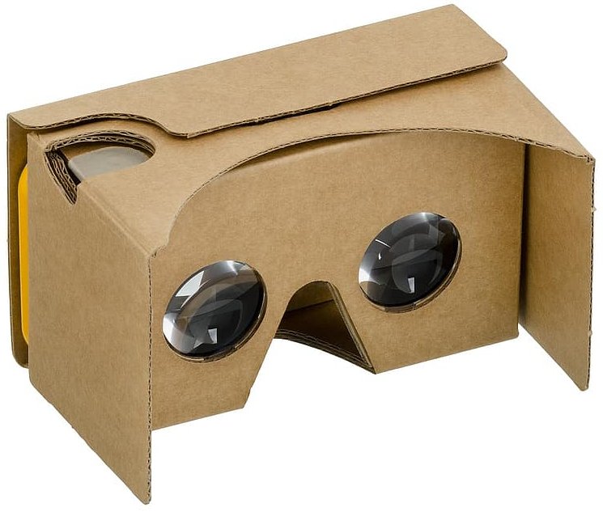
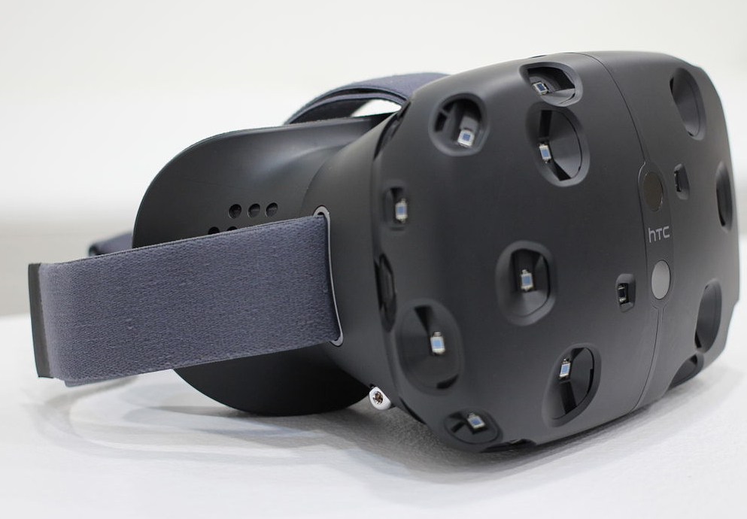
Project Plan: Market Research
ProctorU
Popular online proctoring service
Lockdown browser, live monitor
Students still cheat
VR Headsets
HTC Vive, Oculus Rift (top of the line)
Google Cardboard (bottom of the line)
Notes:
Ehren:
Example - Proctor U and other VR headsets as well as their limitations

Slide 12
Project Plan: Tasks
Hardware:
Power Source
Wifi Connection
Secure Data Transfer
User Input
Screen/Optics:
Display images to User
Update display based on user interaction
Software:
Data from server received and displayed
User Interface designed for the User
Notifications are delivered to User
Notes:
Ehren

Slide 13
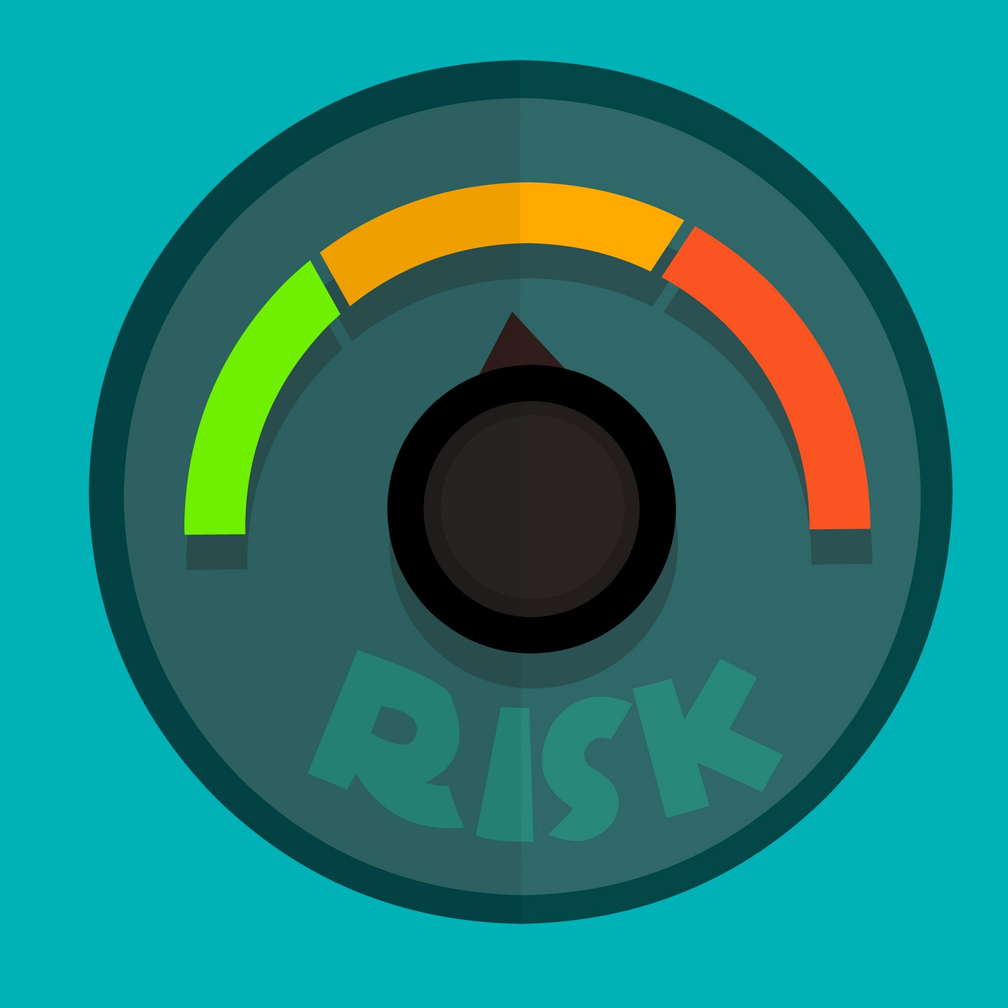
Project Plan: Risks and Mitigation
Risk | Mitigation Plan
Product Vulnerability | Purchase Security Software
Team Lacks Required Knowledge | Seek Outside Expertise
Development Costs | Limit Features to Budget
Project Requirements Not Reflected in Breakdown | Clarify Requirements Early and Often
Project Pace | Include Buffer Time in Project Schedule
Project Scope | Narrow Scope for Minimum Viable Product

Slide 14
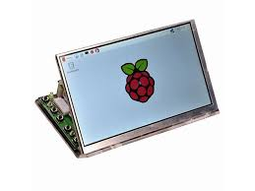
System Design (Functional Decomposition)
The device will use a linux operating system that is to run on a Raspberry Pi Zero W
The device will have 2 main inputs
All visuals will be presented on 2 screens
The device will be constantly plugged in
Notes:
Asa

Slide 15
System Design (Detailed Design)
No specific layouts for interfaces or UI have been set as of this time, several things we have in consideration are as follows:
Minimal options for what to select
Minimal screen clutter
Notes:
Asa

Slide 16
System Design (Hardware/Software)
Raspberry Pi Zero W compatible hardware will be used
Software will conform to QTI standards
The device will using a linux operating system
The device will communicate with a testing service such as TAO
Notes:
Asa

Slide 17
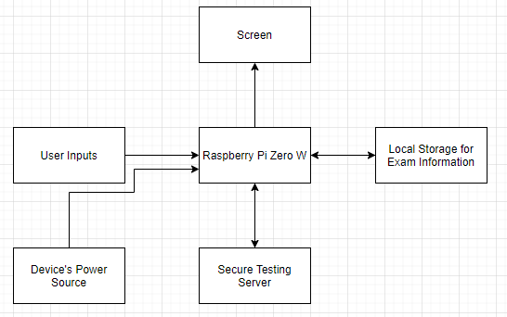
System Design (Component Diagram)
Notes:
Asa

Slide 18
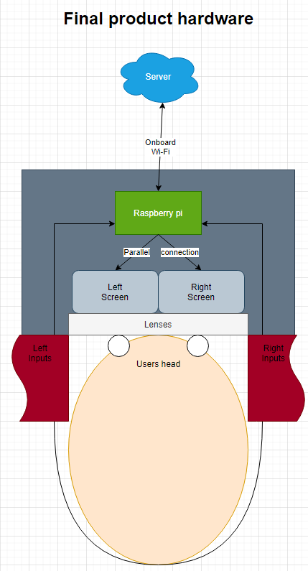
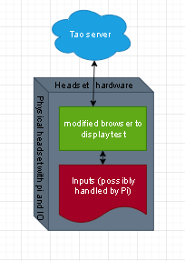
Conceptual Design Diagram
Notes:
Rob HW and SW diagrams

Slide 19
Prototype Implementations
Research
Display types
Microcontroller and microcomputers
VR vs AR
Testing services
Optics and vision accommodations
Wifi vs cellular
Download vs streaming
Security of data transfer
Notes:
Morgan: plan to implement
still finishing up plans so no official implementation yet
research: display types, microcontrollers and microcomputers (raspberry pi), vr and ar (vr decreases cheating abilities without monitoring), testing services (tao open source), optics (lenses for VR and vision accommodations), wifi and cellular speeds, download vs streaming, encryption/security

Slide 20
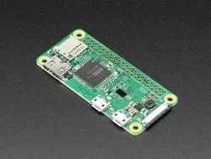
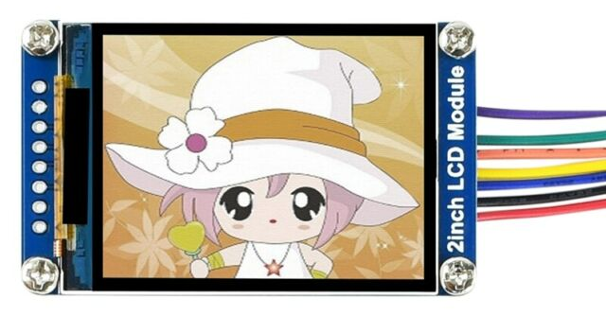
Prototype Implementations
Raspberry Pi Zero W
IPS LCDs
Wifi communication
Keyboard/mouse
Display text to screen
TAO Testing software
Headset casing
Additional features
Notes:
Morgan:
get raspberry pi 0W
connect to two 240x320 IPS LCDs
wifi communication
use keyboard and mouse to interact
display text to screen
Tao Testing software
headset casing
additional features: buttons, modified Tao software, adjustable lenses, cellular data transfer

Slide 21
Project Plan: Milestones
Five Planned Milestones:
Data Transfer
Hardware
Software
Screen/Optics
Power Supply
Notes:
Ehren

Slide 22
Project Plan: Progress Metrics
Data Transfer
No loss of data during transmission to and from headset
Secure transfer of information
Notifications on attempted breaches
Hardware
Hardware fits into headset and headset fits comfortably
Hardware connected to headset software (buttons, etc)
User Interaction
Users can use buttons to interact with headset interface
Users are able to navigate exam content
Notes:
Ehren: These are the metrics that we will

Slide 23
Project Plan: Progress Metrics
Screen/Optics
Hello, world is visible
Display updates with user interaction
Power Source
Successfully powers device
User notified of power status
Emergency battery has enough charge to save and transmit test data before headset powers off

Slide 24
Project Plan: Schedule

Slide 25
Project Plan: Schedule

Slide 26
Test Plan
Unit and integration testing
Performed iteratively as we develop new features
May be performed on a partial prototype
e.g. we may test software functionality with a keyboard before we have our final controls implemented
Some important units:
User interface
Backend
Physical display (LCDs)
Controls

Slide 27
Test Plan
Acceptance testing
Performed with a completed prototype
End-to-end tests defined by use cases
Important use cases will be defined by client
Some important use cases:
User can open an exam using the headset
User can submit answers
User can navigate between questions
User can submit an exam to be graded

Slide 28
Conclusions
We focused on narrowing down the product this semester
Research
Design
Next semester will be all about assembly
Prototype iterations
Order parts over break
Notes:
Rob

Slide 29
Team member contributions
Rob (facilitator)
Team Lead
Morgan (Meeting Scribe)
Document meetings, handle communication
Nathan
Handle biweekly reports and website, handle group submissions
Notes:
Rob

Slide 30
Team member contributions
Zach
Research
Brainstorming
Asa (Hardware Lead)
Hardware research
Hardware breakdown
Ehren
Design document
External projects
Notes:
Rob

Slide 31
Questions?

Slide 32
Thank you

