Slide 1
Wearable Displays
Nathan Andersen
491 Team 1

Slide 2
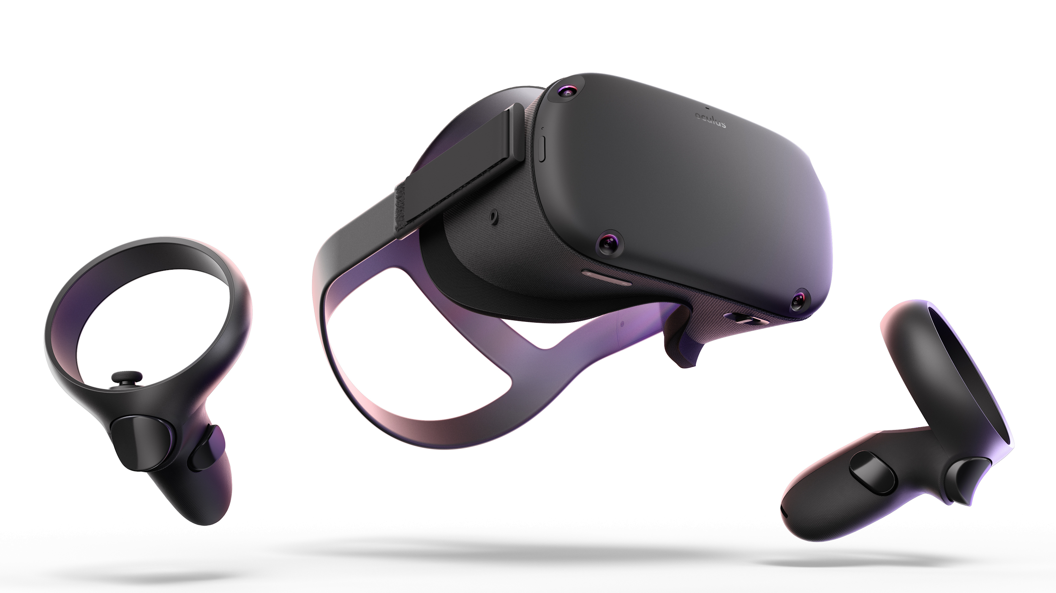
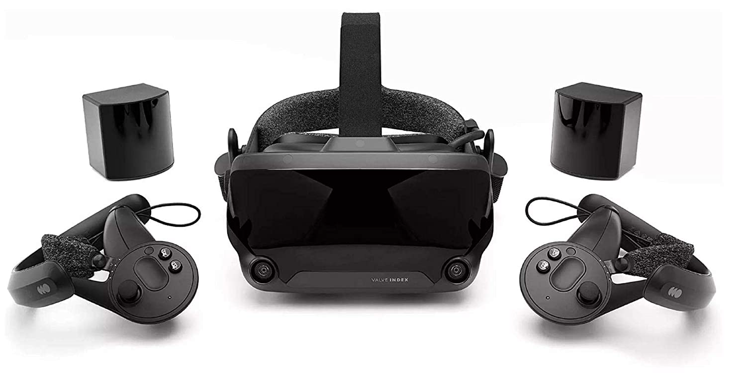
Prebuilt VR
Pros | Cons
System build for us Comes with controllers Sensors already built into headset | Expensive ($400+) Systems aren’t designed for building on Data security? Most need outside device to use User can’t see outside world
Oculus Quest and Valve Index VR headsets & Controllers
Notes:
Here you have you VR. Most VR headsets that we could easily purchase would be gaming VR headsets.
Pros: Have a completed device with controllers
Cons: Expensive
Not really able to build off of it
Security might be a concern, a lot need to run off a computer
$400 Oculus Quest
$500-$750 Valve Index

Slide 3
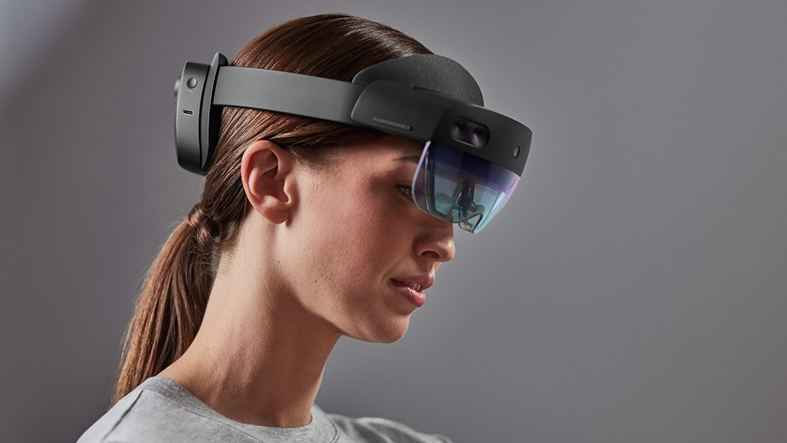
Prebuilt AR
Pros | Cons
System build for us Sensors already built into headset User can see environment and display | Even more Expensive ($3500) Data security?
Microsoft Hololens 2
Notes:
Pros: Already built devices
Cons: Usually a lot more expensive than VR devices.
Same concern about data, as we didn’t build the platform ourselves
$3500 hololens 2

Slide 4
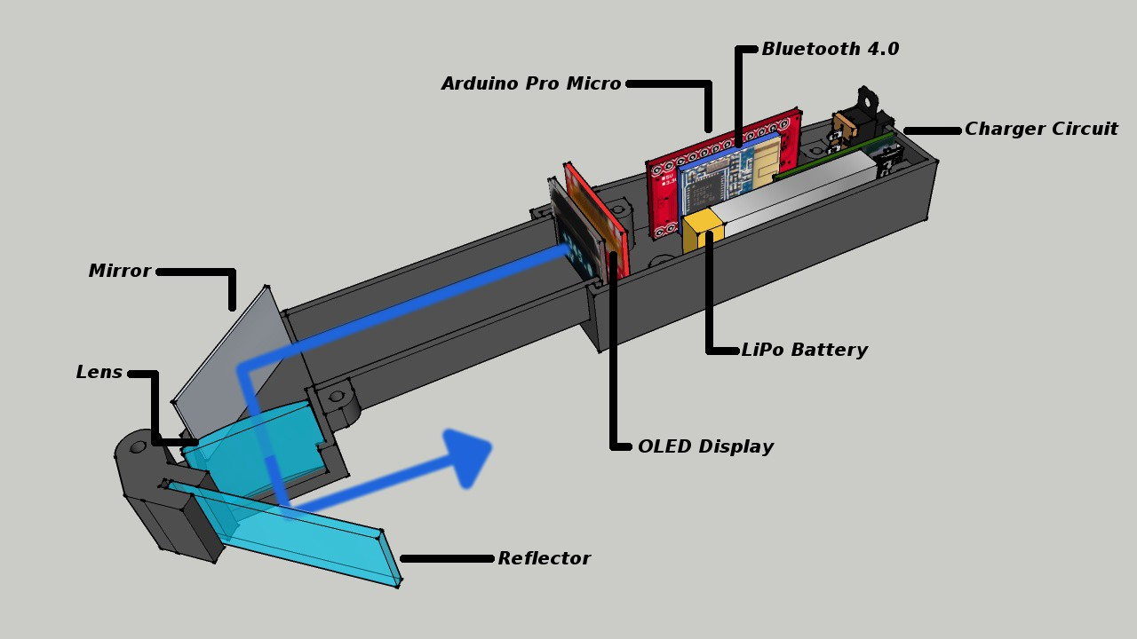
Display using LCD, OLED, or LCoS
Pros | Cons
Many projects similar out there Display module producible by us Can completely design housing Cheap | Smaller resolution display Working with optics, team unfamiliar Bulky
https://hackaday.io/project/12211-arduino-glasses-a-hmd-for-multimeter
Notes:
Creating a display a LCD, OLED, or LCoS panel, more info about those technologies next slide
Took an example from a project that I found online. We could create something similar in terms of a display.
Limitations here are resolution. They panel would determine how much we could fit on the display at one time
We’re all unfamiliar with optics. Would take some potential trial and error to get a nice looking image by using the right lense.
Bigger the panel, bigger it is on the side of your head.

Slide 5
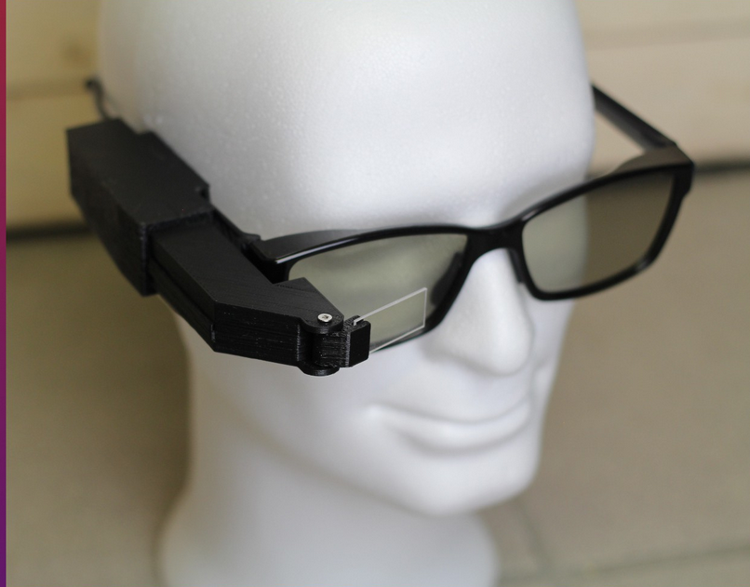
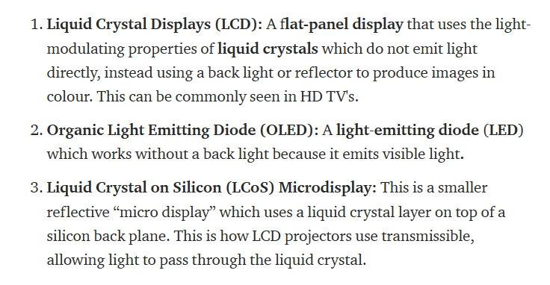
Display using LCD, OLED, or LCoS
https://hackaday.io/project/12211-arduino-glasses-a-hmd-for-multimeter
https://medium.com/@alishbai734/how-display-technologies-work-in-ar-vr-6448445fc9ca

Slide 6
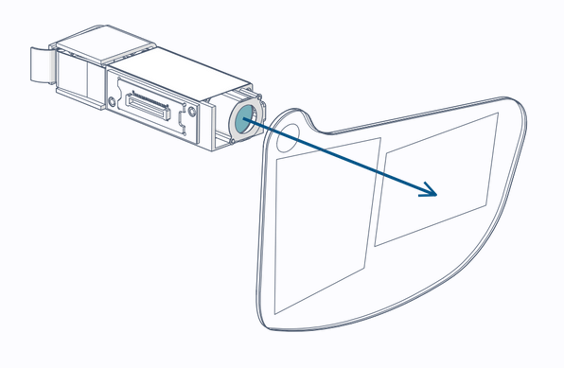
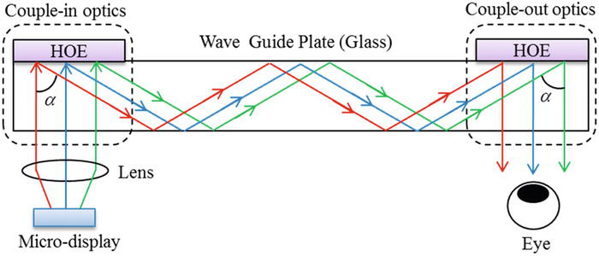
Waveguides
Pros | Cons
Development kits out there Display module producible by us | In development technology Potentially Expensive Not producible by us
https://www.intechopen.com/books/state-of-the-art-virtual-reality-and-augmented-reality-knowhow/waveguide-type-head-mounted-display-system-for-ar-application
Notes:
Waveguides are the latest emerging AR Display technology
I can’t say I’ve really seen a direct definition for the word, but from what I can understand, it’s piece of material that directs an image from the source to your eye.
“The waveguide structure is widely applied in various fields such as electromagnetics, optics, and sound synthesis [6]. It guides the electromagnetic or sound waves through the fibers and pipes. In the optics, it is used as a transmitter that transmits the input signal, the light wave, between two different fields by guiding the waves, without any loss of input information.”
Development of waveguides are currently into development of lenses that you project an image into, and that image is directed into your eyes (and the engine to drive how to project that image)
holographic optical element (HOE) is applied as the in- and out-couplers
https://www.intechopen.com/books/state-of-the-art-virtual-reality-and-augmented-reality-knowhow/waveguide-type-head-mounted-display-system-for-ar-application
https://www.framos.com/us/sed-100a-raspberry-pi-connection-kit-24294

Slide 7
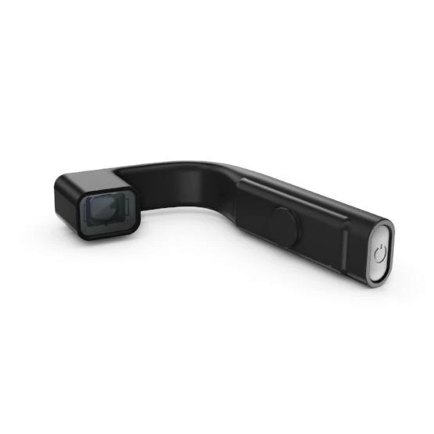
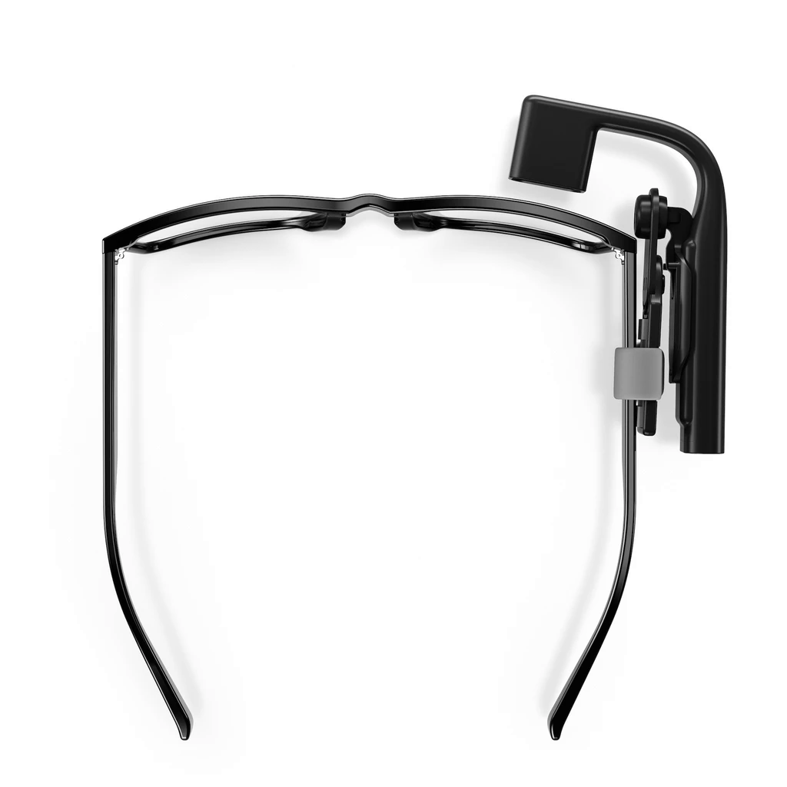
Wearable Displays
Pros | Cons
Display system built for us Clip system allows for use with prescription glasses | Few choices on the market HDMI input Separate battery
Vufine+ Wearable Display
Notes:
https://store.vufine.com/products/vufine-wearable-display-1
$200
Not many products on the market at this time. Device seems to work, modifications would be needed for security and use. Might not be the best way to mass produce them
Clip system it uses seems interesting. Something to potentially take away from it, would allow users with glasses to use it easily.

